Slide 1
Science, Technology, Engineering, and math in golf.
The Master’s Unit
by Mr. Michael C. Knowlton, Santa Rosa County Schools

Slide 2
Course Conditions- Hole #1 Stonebrook Golf Club
Course Rating: 74.3
Slope Rating: 131

Slide 3
Course Conditions- Hole #2 Tanglewood Golf Course
Course Rating: 70.2
Slope Rating: 124

Slide 4
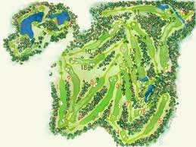
Course Conditions- Hole #3 Augusta National Golf Club
Course Rating: 78.1
Slope Rating: 137

