Slide 1
Commonly misused words #2
•accept - except = accept means to receive, except means to leave out or take
•affect - effect = affect is a verb meaning to influence, effect is a noun meaning result
•capital - capitol = capital is the seat of government, capitol is the building where the legislative body meets
•compliment - complement = compliment is saying something nice, complement is something that completes
•council - counsel = council is a group, counsel is a verb meaning advise
•descent - dissent = descent means a decline, dissent means disagree or opposition
•lose - loose = lose means to not win or you can’t find something, loose means roomy or unrestrained
•precede - proceed = precede means to come before, proceed means to continue or go forward
•principal, principle = principal means the main person or part, principle means a fundamental truth
•stationary, stationery = stationary means standing still, stationery means paper to write on
11. I practice so I won’t (lose, loose) the game.
12. The Senate was in session at the (capital, capitol) today.
13. My daughter likes purple (stationary, stationery).
14. The government’s decision met with much (descent, dissent). 15. Everybody likes to receive (compliments, complements).

Slide 2
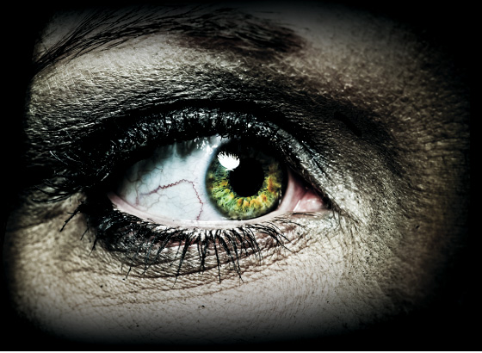
The thrill of Horror
Collection 2

Slide 3
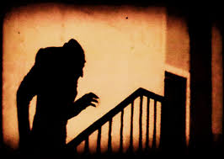
Essential Question
Why does the Horror Genre both terrify and fascinate?

Slide 4
The journey Begins>>> on page 105

Slide 5
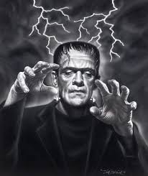
Notes: Analyzing Media
Close-up shot
Low-angle shot
High-angle shot
Point-of-view shot
Lighting
Camera Filters
Music
Words to know. . .

Slide 6
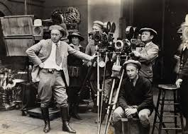
Notes: Analyzing Media
Technique-a way of carrying out a particular task, especially the execution or performance of an artistic work or a scientific procedure.
Directors may use different camera shots to convey ideas, to track character’s emotions, or to show a situation from a character’s point of view. Directors also use other techniques to build suspense.

Slide 7
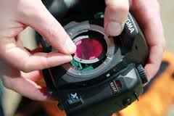
Camera Filters
Camera Filters are glass or plastic disks that are inserted in front of a camera lens. These filters can change the way that images appear, making them clearer, fuzzier, brighter, or darker.

Slide 8
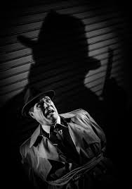
Lighting
Lighting can create moods that are gloomy, mysterious, or scary. Suspenseful movies often use minimal lighting with frequent use of shadows.

Slide 9
Notes: Film Techniques
Music
Music can signal dramatic events or tense moments! Music sometimes foreshadows or hints at what is going to happen (think JAWS).

Slide 10
film
Setting a Purpose: Keep your reading of the short story by WW Jacobs in mind as you view the film and pay attention to any differences you notice between the content of the text version of the story and the content of the film. Think about how any differences affect the story being told.
Jot down any differences you notice between the film and the short story.

Slide 11
Film day 2
As you watch, complete a chart like the one shown below to identify three of the techniques the director used. Then explain which one you found most effective and why.
Close-up shot
Low-angle shot
High-angle shot
Point-of-View shot
Lighting
Camera Filters
Music
Setup your chart like this!
Techniques include:
Technique | Part in the Film | Effect of the Technique
1.
2.
3.

Slide 12
“Text vs. Film” chart(WC)
Setup your chart like this!
Text Vs. Film Chart
Compare the events, the characters, and settings.
 | Story | Film
Events
Characters
Setting

Slide 13
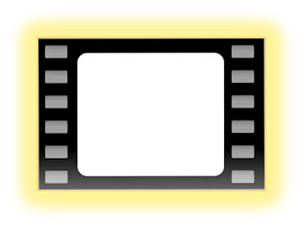
“Text vs. Film” chart(WC)
Compare the events, the characters, and settings.
Does the film give more information about the plot than the written work?
Does the film include all of the events from the story?
Why might the director have omitted those characters?
Are all the characters from the written work included in the film?
How does that affect the plot?
If not, why does the director change the time or place?
 | Story | Film
Events
Characters
Setting
Is the setting in the film the same as the written work?
How does that affect the story?

Slide 14
“Film Comparison and Summary” Exit slip
Use your Text vs. Film Chart to write a 5-10 sentence summary comparing the characters, setting, and the plot for the movie and short story of “The Monkey’s Paw.”

Slide 15
Notes: Analyzing Media
Students will be able to understand a movie’s impact on viewers by analyzing the choices a filmmaker makes when deciding to adapt a written story to movie form.

Slide 16
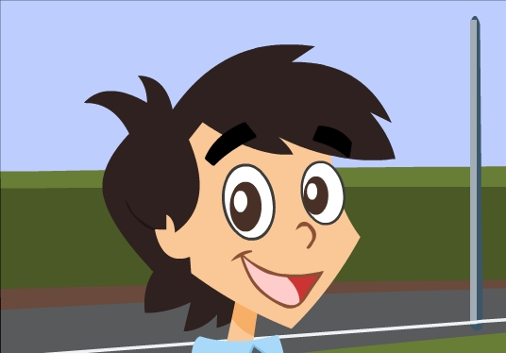
Notes: Analyzing Media
Close-up shot
What it is:
a shot that focuses on one character’s face
Why it is used:
To express a characters emotions or thoughts.

Slide 17
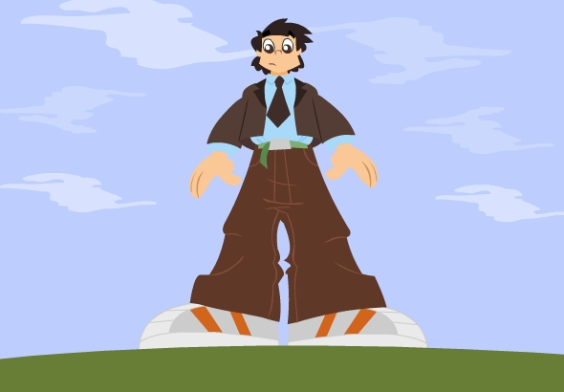
Notes: Analyzing Media
Low-angle shot
What it is:
a shot in which the camera looks up at a subject.
Why it is used:
to create the impression of height or distance; to make a subject look more threatening.

Slide 18
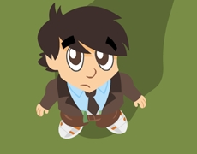
Notes: Analyzing Media
High-angle shot
What it is:
a shot in which the camera looks down on a subject.
Why it is used:
to show a character in relation to his or her surroundings; to make a subject look unprotected or exposed.

Slide 19
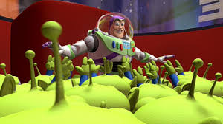
Notes: Analyzing Media
Point- of- View shot
What it is:
a shot that shows what a character sees.
Why it is used:
To let viewers see what is happening from a character’s point of view.

Slide 20
Film day 2
As you watch, complete a chart like the one shown below to identify three of the techniques the director used. Then explain which one you found most effective and why.
Close-up shot
Low-angle shot
High-angle shot
Point-of-View shot
Lighting
Camera Filters
Music
Setup your chart like this!
Techniques include:
Technique | Part in the Film | Effect of the Technique
1.
2.
3.

Slide 21
Film day 2 WARM-UP
As you watch, use your notes to identify different techniques the director uses. What effects do these techniques have? Why do you think the director chose these techniques?
Lighting
Camera Filters
Music
Close-up shot
Low-angle shot
High-angle shot
Point-of-View shot
Techniques include:

