Slide 1
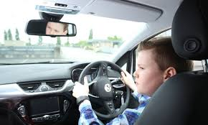
Is 16 Too Young to Drive? Article by Robert Davis
p. 247

Slide 2
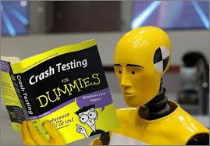
Fatal Car Crashes Drop for 16-Year-Olds, Rise for Older Teens Article by Allison Aubrey
p. 256

Slide 3
Why are we reading these texts?
Articles about similar or related topics allow students to compare and contrast information and ideas. These texts explore a topic of great interest to young people-driving-while providing an opportunity to analyze and interpret the facts they encounter in their reading.

Slide 4
Setting a Purpose
As you read, think about the points each writer makes regarding the age requirements for drivers. Look for evidence that supports each point.

Slide 5
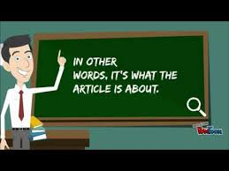
Stop #1 Lines 1-7
Remember that the central idea of a piece of writing is the main concept a writer wants to convey.
Identify the statement that describes the central idea of the article.

Slide 6
Stop #2 Lines 39-49
Authors use details to support a central, or main, idea. Details are specific facts, statistics, or quotations that tell more about the central idea.
Which details support the author’s statement that states have begun to restrict 16- year- old drivers?

Slide 7
Stop # 3 Lines 55-68
Readers draw conclusions when they make a judgement based on evidence, experience, and reasoning.
What conclusions can you draw about what a “Baby boomlet” is? Why does it create urgency about laws related to teenage drivers?

Slide 8
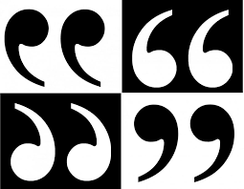
Stop # 4 Lines 84-88
Quotations can be used to support a central idea. Writers often use quotations from experts, people with skills or knowledge of a particular topic.
In what way might the speaker be considered an expert about teenage driving?

Slide 9
Stop #5 Lines 99-103
What is one reason some parents do not want to increase the driving age?

Slide 10
Stop # 6 Lines 119-124
The author uses the word novice to describe the type of teenage drivers who are most often involved in accidents.
Why would a novice have more accidents than other drivers?

Slide 11
Stop #7 Lines 136-151
Authors provide details to support a central idea. Furthermore, a variety of effective supporting details make it more likely that readers will accept and agree with the author’s central idea.
Which scientific evidence is included that supports the idea that the teenage brain is not fully developed yet?

Slide 12
Stop #8 181-188
Authors use descriptive language and idioms to make their points more clearly. An idiom is an expression that has a meaning that is different from the meaning of its individual words.
Identify the idiom the author uses and explain its meaning.

Slide 13
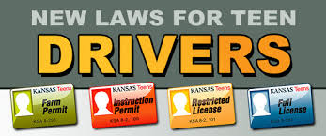
Stop #9 Lines 211-225
When reading an informational article, pay close attention to facts, details, and other support for the writer’s central idea. Sometimes, readers must weigh the relevance of that support and decide whether it is sufficient or helpful. Although facts and statistics may seem especially convincing, they might not provide the whole picture.
Identify the details that explain “graduated licensing”.
Why should readers be careful about interpreting the effectiveness of these rules?

Slide 14
Stop # 10 Lines 242-255
Authors may support a central idea by making a comparison to a similar situation.
What comparison does the author use to end the article?

Slide 15
Fatal Car Crashes Drop for 16-Year-Olds, Rise for Older Teens Article by Allison Aubrey
p. 256

Slide 16
Stop #1 Lines 21-25
What is the central idea of the article?

Slide 17
Stop # 2 Lines 1-20
What conclusions can you draw about why there are fewer laws designed to restrict 18-year-old drivers or force them to take driver’s education?

