Slide 1
Commonly misused words #2
•accept - except = accept means to receive, except means to leave out or take
•affect - effect = affect is a verb meaning to influence, effect is a noun meaning result
•capital - capitol = capital is the seat of government, capitol is the building where the legislative body meets
•compliment - complement = compliment is saying something nice, complement is something that completes
•council - counsel = council is a group, counsel is a verb meaning advise
•descent - dissent = descent means a decline, dissent means disagree or opposition
•lose - loose = lose means to not win or you can’t find something, loose means roomy or unrestrained
•precede - proceed = precede means to come before, proceed means to continue or go forward
•principal, principle = principal means the main person or part, principle means a fundamental truth
•stationary, stationery = stationary means standing still, stationery means paper to write on
1. The school (principal, principle) came in to the room. 2. My pants are too (lose, loose).
3. We went before the teen (council, counsel). 4. The (capital, capitol) of Colorado is Denver.

Slide 2
Word Within the Word List VII
Stem | Definition
Aqua- | water
Audi- | hear
Bell- | war
Cap- | take

Slide 3
The thrill of Horror
Collection 2

Slide 4
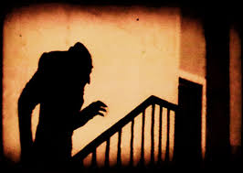
Essential Question
Why does the Horror Genre both terrify and fascinate?

Slide 5
Interactive Note Session
Collaborate in small groups to investigate important terms and ideas before we read “The Monkey’s Paw”.
Be sure to:
Click the links!
Write down what you think is important including Language Arts terms, vocabulary, concepts, and about the author.
Use the powerpoint, textbook, and the web to take thorough notes that can be used on tests and quizzes!

Slide 6
Notes
Foreshadowing
Theme
Universal Theme
Imagery
Dialogue
Inferences
Allusion
The student will be able to formulate and analyze a universal theme and explain foreshadowing in a short story.

Slide 7
A closer look at our goal
The student will be able to formulate (Create or put together) and analyze (Break it down into parts, then, tell about the parts of) a universal theme and to explain (teach me or show me, tell me the steps of)foreshadowing in a short story.

Slide 8
Notes
Foreshadowing refers to clues an author gives that hint at what will happen later in the story.
One way authors foreshadow events is through description. They drop hints early in the story to set the tone for things to come.

Slide 9
Notes Activity
Foreshadowing refers to clues an author gives that hint at what will happen later in the story.
Function of Foreshadowing
Generally, the function of foreshadowing is to build anticipation in the minds of readers about what might happen next and thus adding dramatic tension to a story. It is deliberately employed to create suspense in mystery novels, usually by giving false clues or “red herrings” to distract readers.
Moreover, foreshadowing can make extraordinary and bizarre events appear credible as the events are predicted beforehand, so that readers are mentally prepared for them.

Slide 10
Notes Activity
Foreshadowing refers to clues an author gives that hint at what will happen later in the story.
Listen to the recording.
If you’ve seen the movie JAWS, you already know.
https://www.youtube.com/watch?v=5tMqcARKRSE
Sometimes what’s going to happen later in the story is foreshadowed long before it happens. Other times, we are given a clue as to what is about to happen, just before it occurs! Either way, it’s all foreshadowing!
Q: What event is being foreshadowed and how do they give the audience the clue?

Slide 11
Examples of foreshadowing
Foreshadowing refers to clues an author gives that hint at what will happen later in the story.
Heightened concern is also used to foreshadow events. A child leaves the house and the parent is overly concerned about them. The child tells the parent not to worry, that everything will be fine. Readers will see this worry as a precursor to danger coming soon.
A pre-scene shows something that will reoccur. For example, in a western movie, the good guy enters a bar, has a drink, and leaves. The bad guy scowls and spits on the floor and you know there is definitely more to come between them.
A character’s thoughts can foreshadow. For example, “I told myself this is the end of my trouble, but I didn’t believe myself.”
Narration can foreshadow by telling you something is going to happen. Details are often left out, but the suspense is created to keep interest. For examples, the character wakes up and the narration talks about how this is going to be the longest day of his life.

Slide 12
Notes: Theme
Darkness and lightness
Theme is a message about life or human nature that a writer wants to share with readers.
Power and corruption
Lost love
Love and sacrifice
Overcoming
Sometimes, a writer actually states the theme of the story.
Other times, readers must infer (figure out) the theme from details the writer provides.
Universal themes
Winning and losing
Growing Up
Beating the odds
Common sense
Peer pressure
Man vs nature
Abuse of power

Slide 13
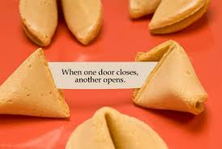
Notes: Theme
One way to determine a story’s theme is to ask, “What lesson does the main character learn that applies to real people’s lives?”
Watch the video to complete your notes about theme.
https://www.youtube.com/watch?v=hQqE9pFFkOc

Slide 14
Notes: New Vocabulary
Peril
Condole
Grimace
Fate
Credulity
Prosaic
simian
Compensation
Resignation
Research and define the new vocabulary words.

Slide 15
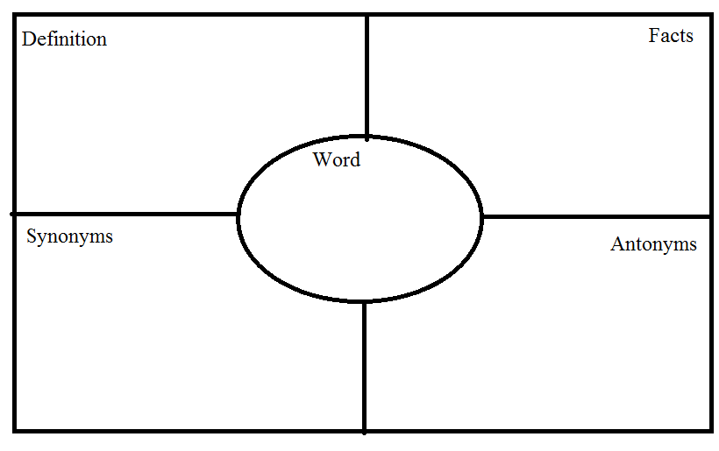
Notes: New Vocabulary
Research and define the new vocabulary words.
Then, pick (1) term and create a Frayer model.
Peril
Condole
Grimace
Fate
Credulity
Prosaic
Compensation
Resignation

Slide 16
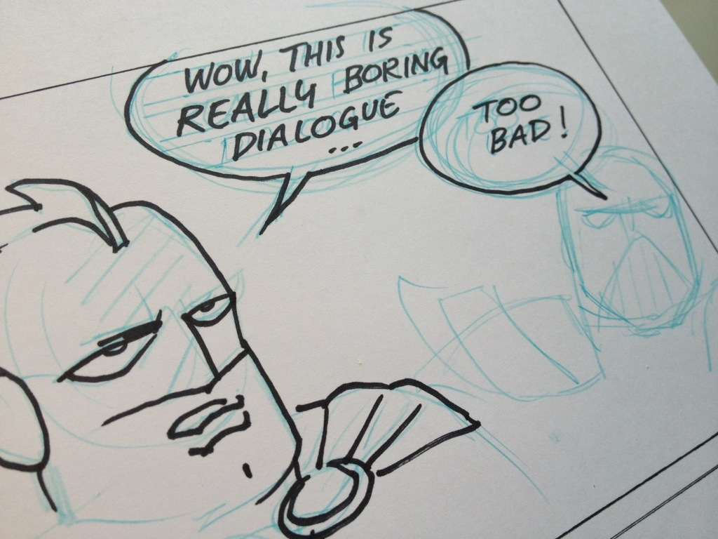
Notes: Dialogue
Dialogue- the words spoken by the characters in a story. *While narration makes readers feel they are being told a story, dialogue makes readers feel like they are in the story.

Slide 17
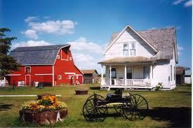
Notes: INferences
Inferences- When you use facts and evidence from the text to figure out parts of the story that the author does not state directly.
Who might live here?
What facts give us a clue?
https://www.youtube.com/watch?v=ioZW58bOBFE

Slide 18
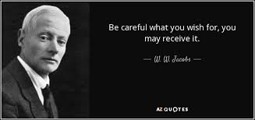
About the Author
William Wymark Jacobs (1863-1943) grew up in London near the waterfront wharfs. As a boy, Jacobs absorbed the tales of the strange, distant lands told by passing sailors. As a young man, Jacobs worked at a bank- a job that he hated- and wrote stories in his spare time. He eventually became a popular writer of humor. Ironically, his best-known work, “The Monkey’s Paw,” became a classic of the horror genre.

Slide 19
About the Author: Activity
Use technology to research the life of WW Jacobs (10 Minutes)
Despite authoring “The Monkey’s Paw,” WW Jacobs was known mostly for having what kind of tone in his stories?
What were his favorite subjects to write about?
Michael Sadleir described Jacobs' fiction thus: “He wrote stories of three kinds; describing the misadventures of sailor-men ashore; celebrating the artful dodger of a slow-witted village; and tales of the macabre".^{[6](Wikipedia).}
What is meant by “tales of the macabre”?

Slide 20
audio
https://www.youtube.com/watch?v=PFxUBqOfje4
The student will be able to formulate and analyze a universal theme and to explain foreshadowing in a short story.

Slide 21
audio
https://www.youtube.com/watch?v=PFxUBqOfje4
“The Monkey’s Paw” Questions

Slide 22
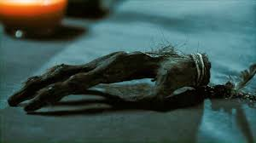
The Monkey’s Paw 2-1-4
Intro- 2-1-4
Can we predict what the story will be about after only hearing two facts, one clue, and four images?

Slide 23
Two facts
Fact #1- The Monkey’s Paw is a supernatural short story first published in 1902 and written by W.W. Jacobs.
Fact #2- In the story, three wishes are granted to the owner of the Monkey’s paw.

Slide 24
One clue
One theme of the story is that: Unchecked greed only leads to unhappiness, no matter how much more one asks for.

Slide 25
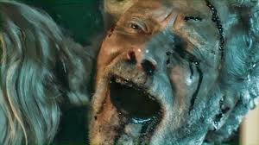
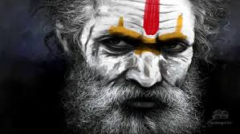

Slide 26
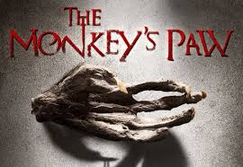
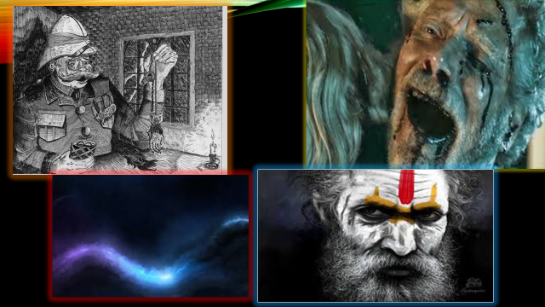
Can you guess my 2-1-4?
Be careful what you wish for. . .
What is this story about?
What about the setting?
Conflict?
How will it be resolved?
How might this story fit into the horror genre?

Slide 27
The journey Begins>>> on page 105

Slide 28
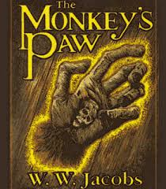
“The Monkeys Paw” Musical Chairs
You will need:
One piece of paper #1-18, skip 2-3 lines in between each number.
A pen or pencil
Title your paper

Slide 29
Details and Setting
For this station, choose one question to research and answer on your own. Then share your answers with fellow members of the group so all questions have been recorded.
Lines 1-10: Which descriptive details help establish the setting?
Lines 3–7: Which details tell something about the father’s personality?
How could this aspect of his personality affect the plot?
Lines 39–42: Explain how this description of Sergeant-Major Morris helps build suspense.

Slide 30
Theme and foreshadowing
5. Lines 73–77: Which ideas in this passage suggest what the theme of this story might be?
6. What might those ideas foreshadow in the story?
7. Lines 90–92: Explain what makes the foreshadowing in these lines effective.
8. Lines 110–116: Look for evidence in these lines of a universal theme related to interfering with fate. Which words warn of interfering with fate?
9. Lines 176–182: Which words and phrases foreshadow something frightening?
10. What effect does this word choice create?

Slide 31
The MAn
10. Lines 214–225: Describe the behavior of the man outside. (10 words or more).
11. What might cause him to act that way?
12. How does this foreshadowing propel the story’s action?

Slide 32
Interfere with fate
13. Lines 271–281: How does the information from the man from Maw and Meggins support the theme of the story?
14. In what way have the Whites interfered with fate?

Slide 33
Coincidence or supernatural?
15. Lines 330–340: In line 332, Mr. White calls the granting of the first wish “a coincidence.”
Does he really believe this? Why does he say it?
16. Lines 344–353: What imagery is in these lines?
17. What might it foreshadow?
17. What effect does it create?

Slide 34
Lesson Learned
18. Lines 385–391: Based on this dialogue between Mr. and Mrs. White, what lesson, if any, has each character learned?
In general, how do the lessons learned by the main characters relate to the theme of the story?

Slide 35
Monkeys paw literary analysis
https://www.youtube.com/watch?v=7eIHTjBJRNI

