Slide 1
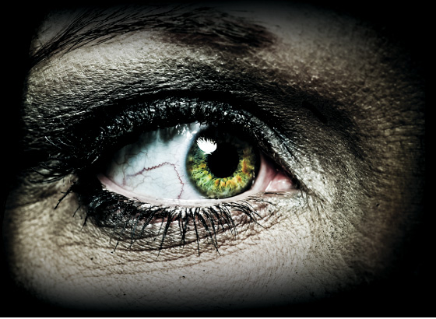
The thrill of Horror
Collection 2

Slide 2
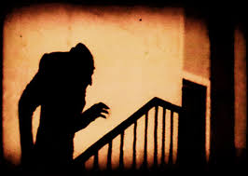
Essential Question
Why does the Horror Genre both terrify and fascinate?

Slide 3
“What is the horror genre?”
One of the pleasures of reading literature is thinking about it afterward.
Literary Criticism is writing that examines, analyzes, and interprets a piece of literature or a general aspect of literature.
In literary criticism, the authors purpose- or the reason he or she is writing-is often to inform or to persuade other readers to view a text in a certain way.

Slide 4
“What is the horror genre?”
authors purpose when writing a literary criticism could be to:
Define a genre- explains the characteristics of a type of writing using specific examples as evidence.
Categorize works of literature- defines and classifies works of literature based on certain criteria, or standards.
To examine the structure of a work of literature- analyzes the organization of a piece of literature.
Analyze an author’s technique- explains and evaluates the effectiveness of literary techniques, such as using an unreliable narrator, recurring imagery, or flashbacks.

Slide 5
Is it a good idea for middle school students to hear scary stories?
Why?
Why NOT?

Slide 6
“Scary Tales” Essay by Jackie Torrence
https://mrknowlton.weebly.com/student-assignments.html
Learning Goal: Students will be able to analyze an essay to determine the author’s viewpoint, counterarguments, and elements of language that contribute to the author’s style.

Slide 7
“Scary Tales” Stations Safari

Slide 8
Stations
Question 1:
What does the author’s grandma mean in lines 8-9 when she says, “Hold it, let me leave the room, lightning’s going to strike”?
***Write a response in 3 or more sentences using text evidence to support your idea.

Slide 9
Stations
Question 2:
Tell what happens when Mr. Hall comes to visit.
***Discuss your response with a partner. Then, draw a picture illustrating what happens.

Slide 10
Stations
Question 3:
An analogy is an extended comparison of two things that are alike in some way. Examine lines 39-42. 1. What two things is the author comparing?
2. Explain what this comparison reveals about the author’s tone, or attitude, toward storytelling.
3. With a partner, create an analogy to describe two things that are alike in some way.
***Write your response in bulleted format. Be sure to answer all 3 parts of the question. Label each part of your response. EX. #3: food is to eat as water is to drink.

Slide 11
Stations
Question 4:
What does Grandpa Jim mean when he tells his granddaughter that “only fools rush in where angels fear to tread”? Explain what lesson scary stories can help teach.
***Discuss with a partner. Then, write a 3-5 sentence response.

Slide 12
Stations
Question 5:
How would you describe Torrance’s viewpoint on scary tales? Explain how her values, beliefs, and background contribute to the way she thinks about this topic.
***Answer in as few words as possible that still communicates an accurate response!

Slide 13
Stations
Question 6:
Are the author’s counterarguments effective in proving her own view?
Why or why not?
***Write a 3-5 sentence response that includes text evidence.

Slide 14
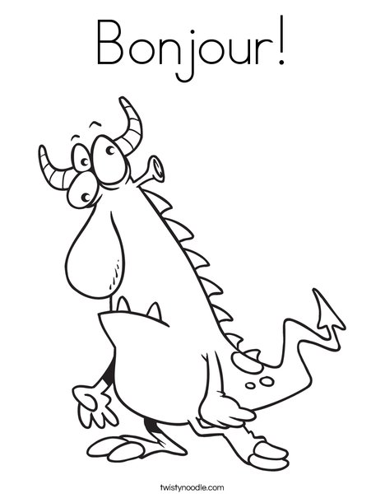
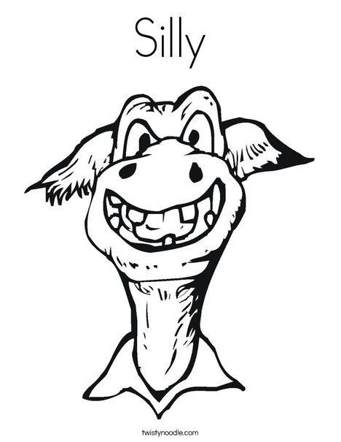
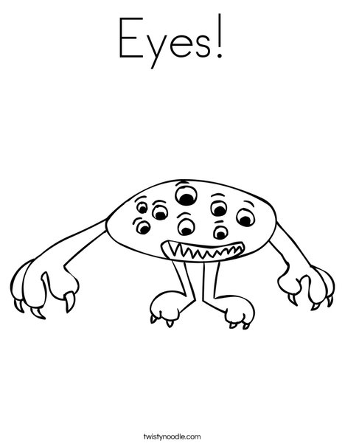
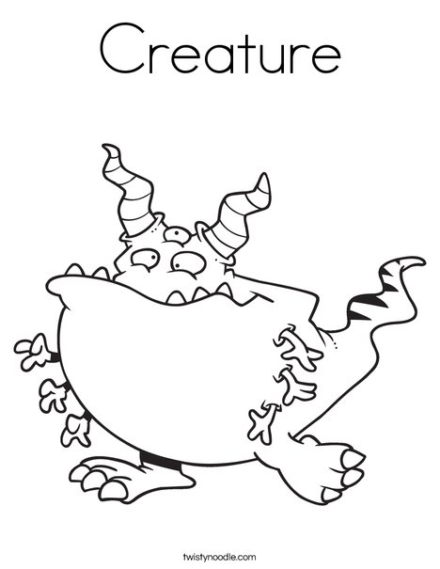
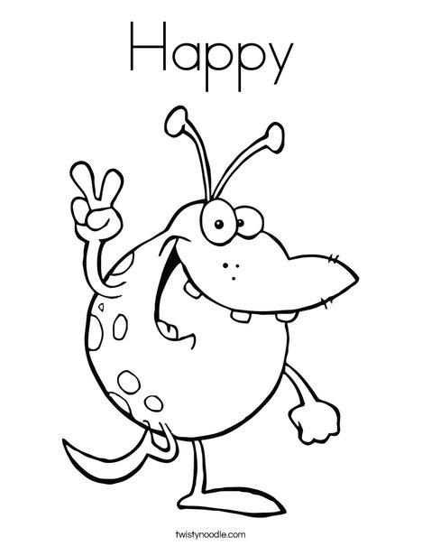
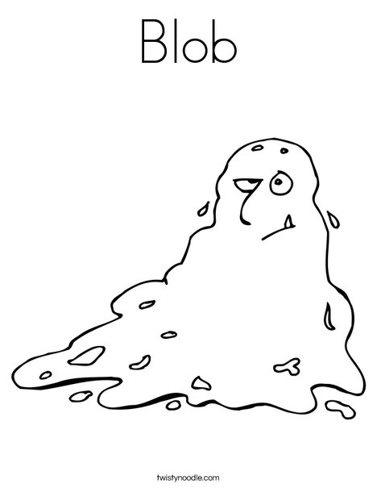
Catch em’ all
If your team is able to complete the mission during the time allowed at each station, take a trophy monster! Do not steal a monster if your group did not complete the task. There are prizes for the team who can catch the most monsters on your safari!

Slide 15
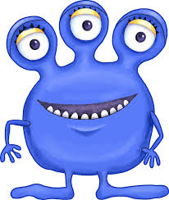
Monster safari- Leaderboard
Class: | Period 2 | Period 3 | Period 4 | Period 5 | Period 6
1st Place Team
2nd Place Team
3rd Place Team

