Slide 1
Holocaust Vocabulary

Slide 2
Vocabulary Set 1
Collaborator – a person who willingly participates in a project or activity.
Perpetrator - a person who carries out a harmful, illegal, or immoral act.
Survivor - a person remaining alive after an event in which others have died.
Bystander – a person who is present at an event or incident but does not take part to stop it, and who may benefit from it.

Slide 3
Vocabulary set I
Liberator - a person who frees another person or place from imprisonment or oppression.
Holocaust – the systematic, bureaucratic, state-sponsored persecution and murder of six million Jews by the Nazi regime and its collaborators.
Antisemitism – hostility or prejudice against Jewish people
Dehumanization - the psychological process of demonizing "the enemy", making them seem less than human and hence not worthy of humane treatment.

Slide 4
Vocabulary Set I
Discrimination - the unjust or prejudicial treatment of different categories of people or things, especially on the grounds of race, religion, age, or gender.
Propaganda – information, especially of a biased or misleading nature, used to promote or publicize a particular political cause or point of view.
Hate group - a social group that advocates and practices hatred, hostility, or violence towards members of a designated sector of society.

Slide 5
Vocabulary set I
Scapegoat - a person who is blamed for the wrongdoings, mistakes, or faults of others, especially for reasons of expediency.
Ideology - a theory or set of beliefs on which a political system, party, or organization is based.
Stereotype - a widely held and oversimplified image or idea of a particular type of person or thing. Often exaggerated or blatantly false.

Slide 6
Anne Frank vocabulary
Carillon – set of bells, commonly found in church towers
Guilders – Danish unit of money
Capitulation - the action of surrender
Conspicuous – attracting notice or attention; standing out

Slide 7
Ration books – books of stamps or coupons issued by the government in wartime. They could be used to buy scarce items, such as food, clothing, and gasoline.
Black market – a system for selling goods illegally.
Mercurial – subject to unpredictable changes of mood or mind
Abruptly – suddenly or unexpectedly
w.c. - another term for the toilet

Slide 8
Gestapo – Nazi secret police force, known for its terrorism and brutality
Symbol – a person, place, or object whose meaning extends beyond itself.
Contrast – to highlight the differences between two or more subjects
Situational irony – a contrast between what a character or reader expects to happen and what actually happens. (you expect a good night kiss and get slapped instead)
Dramatic irony – the reader or viewer knows something that the character does not know. (think horror movie, when you yell at a character not to go down into the basement because as a viewer, you know there is a creepy clown down there...)

Slide 9
Verbal irony – someone says the opposite of what they mean (sarcasm is a form of this)
Drama – any play, whether comedic or tragic
Cast – all the characters in a play
Playwright – the author of a play
Also remember literary terms and figurative language: (Simile, metaphor, connotation, denotation, pun, hyperbole, imagery, dialogue, etc.)

Slide 10
You will be asked to analyze two pieces of literature:
1) The History Teacher by Billy Collins
2) The Butterfly by Pavel Friedmaan

Slide 11
The History Teacher by Billy Collins
The History Teacher by Billy Collins

Slide 12
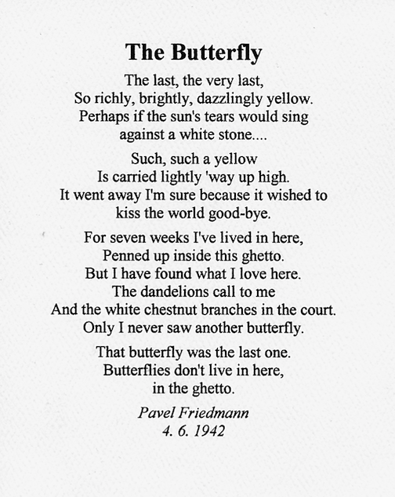
The Butterfly by Pavel Friedmaan

