Slide 1
Commonly misused words #3
Directions: Write a sentence with the given confusing words.
10. there- _________________________________________________
11. their- __________________________________________________

Slide 2
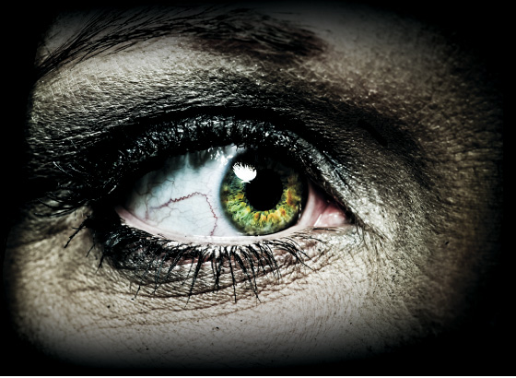
The thrill of Horror
Collection 2

Slide 3
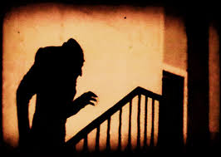
Essential Question
Why does the Horror Genre both terrify and fascinate?

Slide 5
Objectives:
Students will be able to analyze a story to determine the point of view from which the story is told.
Students will be able to evaluate the credibility or trustworthiness of a narrator.
Students will be able to identify techniques used to create suspense in a fictional story.

Slide 6
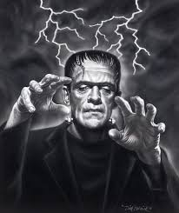
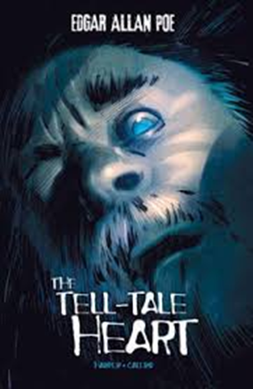
Notes: “The Tell-Tale Heart”
1st Person Point of View
3rd Person POV
Unreliable Narrator
Repetition
Suspense
Narrator
Words to know

Slide 7
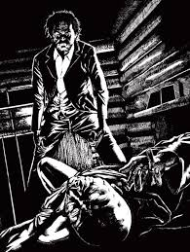
Vocabulary: “The Tell-Tale Heart”
Conceive
Vex
Stifle
Crevice
Audacity
Vehemently
Derision
Hypocritical
Words to know

Slide 8
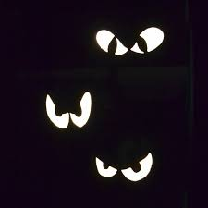
Point of view
UNDERSTANDING POINT OF VIEW IN LITERATURE
Literature provides a lens through which readers look at the world. Point of view is the way the author allows you to “see” and “hear” what’s going on. Skillful authors can fix their readers’ attention on exactly the detail, opinion, or emotion the author wants to emphasize by manipulating the point of view of the story.
WHAT ARE THE KINDS OF POINT OF VIEW IN LITERATURE?
Point of view comes in three varieties, which the English scholars have handily numbered for your convenience: 1st, 2nd, and 3rd point of view.

Slide 9
1st person point of view
First-person point of view is in use when a character narrates the story with I-me-my-mine in his or her speech. The advantage of this point of view is that you get to hear the thoughts of the narrator and see the world depicted in the story through his or her eyes. However, remember that no narrator, like no human being, has complete self-knowledge or, for that matter, complete knowledge of anything. Therefore, the reader’s role is to go beyond what the narrator says.

Slide 10
2nd person point of view
Second-person point of view, in which the author uses you and your, is rare; authors seldom speak directly to the reader. When you encounter this point of view, pay attention. Why? The author has made a daring choice, probably with a specific purpose in mind. Most times, second-person point of view draws the reader into the story, almost making the reader a participant in the action.

Slide 11
3rd person point of view
Third-person point of view is that of an outsider looking at the action. The writer may choose third-person omniscient, in which the thoughts of every character are open to the reader, or third-person limited, in which the reader enters only one character’s mind, either throughout the entire work or in a specific section. Third-person limited differs from first-person because the author’s voice, not the character’s voice, is what you hear in the descriptive passages.

Slide 12
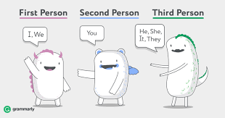
Point of view practice
https://quizlet.com/235876563/point-of-view-flash-cards/

Slide 13
Unreliable narrator
An unreliable narrator is one whose assessment of events cannot be trusted for some reason.
Characteristics of an unreliable narrator:
•usually comes from first person point of view •biased for/against other characters •makes mistakes •missing or incorrect info
How and why would a narrator be considered unreliable or untrustworthy?
Mental illness
Prejudice
Age difference

Slide 14
Unreliable narrator
What is an unreliable narrator’s effect on the reader?
The reader can only see what narrator sees;
The reader must form his/her own opinions;
The reader can't trust the narrator;
The reader must make inferences from clues

Slide 15
Unreliable narrator Practice
https://quizlet.com/202765069/unreliable-narrator-flash-cards/

Slide 16
Repetition
Repetition is the use of the same word or words more than once.
The effect of repetition may:
Emphasize a particular idea
Help create suspense

Slide 17
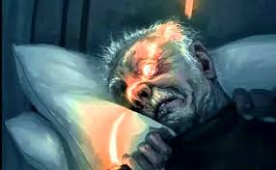
Repetition example
“It was open- wide, wide open- and I grew furious as I gazed upon it.”(Poe, p.91, Lines 94-95).
Which words are repeated?
What does the repetition emphasize?

Slide 18
Suspense
Suspense is a sense of growing tension, fear, and excitement felt by readers.
Suspense can be created by describing a character’s anxiety, by using imagery to tell about dramatic events, or by repeating words, phrases, or actions.
Remember, imagery is vivid language that appeals to the five senses: taste, touch, sight, sound, and smell.
“But even yet I refrained and kept still. I scarcely breathed. I held the lantern motionless.” (Poe, Lines 106-107).

Slide 19
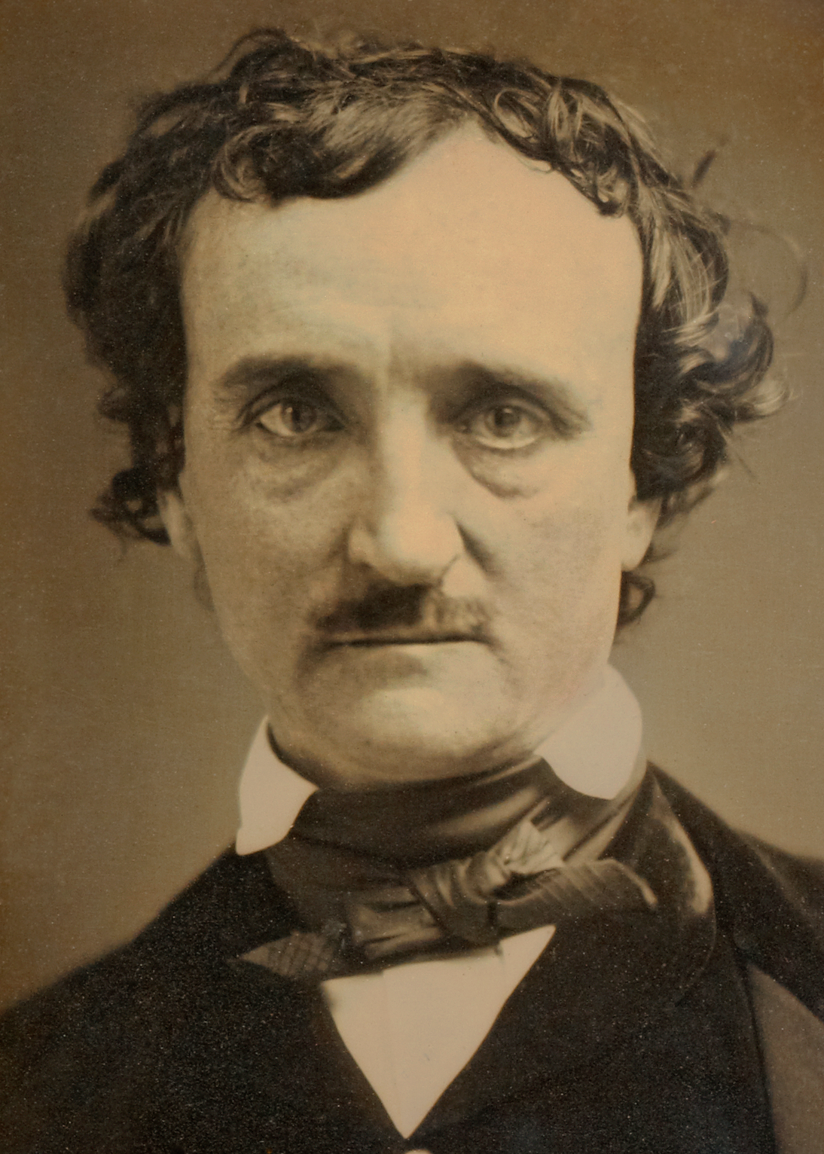
Edgar allan poe
Discovery Education
Great Books: Tales of Edgar Allan Poe
https://www.youtube.com/watch?v=x-387NMCR6w

Slide 20
The tell-tale heart read alouds
http://www.manythings.org/listen/The_Tell-Tale_Heart_-_By_Edgar_Allan_Poe.html
https://librivox.org/short-story-collection-001/

Slide 21
Tell-Tale Heart questions
Collection 2\The Tell-Tale Heart Questions.docx

