Slide 1
https://www.youtube.com/watch?v=RaDMSKZVKNY I, Too
https://www.youtube.com/watch?v=xYouKQ4EESs

Slide 2
Two Sides of the American Dream
“I, Too, Sing America” by Langston Hughes
&
“I Hear America Singing” By Walt Whitman

Slide 3
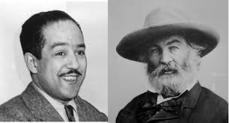

Slide 4
“I Hear America Singing” BY Walt Whitman
Yesterday, we read the poem on our own.
Which ideas could be possible themes in the poem?
America is a great nation comprised of many different individuals
There is pride to be earned through hard work
Together, we are greater than the sum of our parts

Slide 5
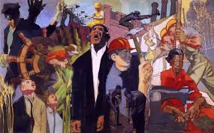
How can we determine theme?
Look at what the characters are doing, saying, or learning from their experience.

Slide 6
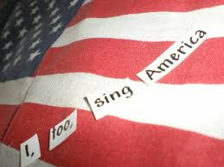
“I, Too, Sing America” by Langston hughes
Which ideas could be a possible theme for this poem?
America has a shameful history of segregation and prejudice.
Even people -who are not currently treated fairly- have hope for the future of America.

Slide 7
A much closer look
Let’s take a look at the most important concepts from the two poems.

Slide 8
#1a Rationale
The correct answer is C.
WHY? this excerpt captures the theme that the beauty of America is built on the unique contributions of individual workers.

Slide 9
#1b Rationale
The correct answer is a.
WHY? The “strong melodious songs” of each American contribute to the beauty of the country.

Slide 10
Structure With a partner, answer number 2 .
Structure of Poetry. Poetry is literature written in stanzas and lines that use rhythm to express feelings and ideas. Poets will pay particular attention to the length, placement, and grouping of lines and stanzas. ... Another aspect of the structure of poems is the rhythm, which is the beat of the poem.
3 minutes

Slide 11
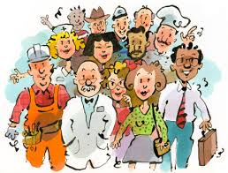
The correct answer is d.
Here’s why:
The varied list of professions emphasizes the individuality of each citizen.

Slide 12
Diction:
Diction Definition. Diction can be defined as style of speaking or writing, determined by the choice of words by a speaker or a writer. ... Proper diction, or proper choice of words, is important to get the message across.
With a partner, answer number 3. .

Slide 13
#3 Rationale
The correct answer is A.
Here’s Why:
The characterization of the mechanics’ songs as “strong” suggests a powerful America built by its workers.

Slide 14
Diction:
Diction Definition. Diction can be defined as style of speaking or writing, determined by the choice of words by a speaker or a writer. ... Proper diction, or proper choice of words, is important to get the message across.
With a partner, answer number 4. .

Slide 15
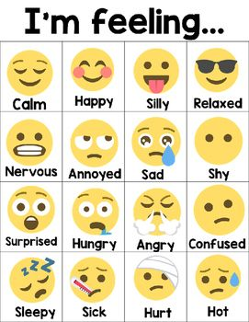
#4 Rationale
“Singing”- evokes a celebratory feeling
“Blithe”- means happy and carefree
“Party” – as with singing, party suggests a celebration
“Robust”- means strong and healthy
“Friendly”- suggests close personal relationships
“Melodious”- means pleasant sound, which evokes a harmonious feeling

Slide 16
Try #5 A & B with a partner
3 minutes

Slide 17
5a rationale
The correct answer is a. Hughes relays the experience of black Americans, often omitted from consideration when describing the American experience.

Slide 18
5B rationale
The correct answer is d. The inclusion of the speaker in “America” is emphasized through the word “too.”

Slide 19
Try #6
1 minute

Slide 20
#6 Rationale
B is correct.
Here’s why:
“Tomorrow” indicates the speaker’s desire for progress to be included “at the table” instead of forced into the kitchen.

Slide 21
EXIT SLIP
On a scale of 1-2, how confident are you investigating and describing figurative language in poetry?
1= no, no, no 2= bring it on, sister

